Slide 1

Registration & Certification of
Savvy Caregiver Program Licenses

Slide 2
Registration & Certification of
Savvy Caregiver® Program Licenses
All Savvy programs delivered since July 1, 2021 must be registered with Savvy Systems for each calendar year. Registration may be completed at any time during the year, including by year-end.
  This includes all adapted versions such as: Express, Advanced, etc.
After all programs are registered for the year, the appropriate organizational representative (e.g., Caregiver Services Director or Executive Director) must submit the “Annual Workshop Licenses Certification” form.
These requirements can be completed in the My Account section of www.savvycaregiver.com.

Slide 3
Registration & Certification Process Steps
Go to www.savvycaregiver.com and log in under the “My Account” tab
Click on “Register Your Workshop Licenses”
Complete Program Registration Information
Certify all Savvy Programs have been Registered

Slide 4
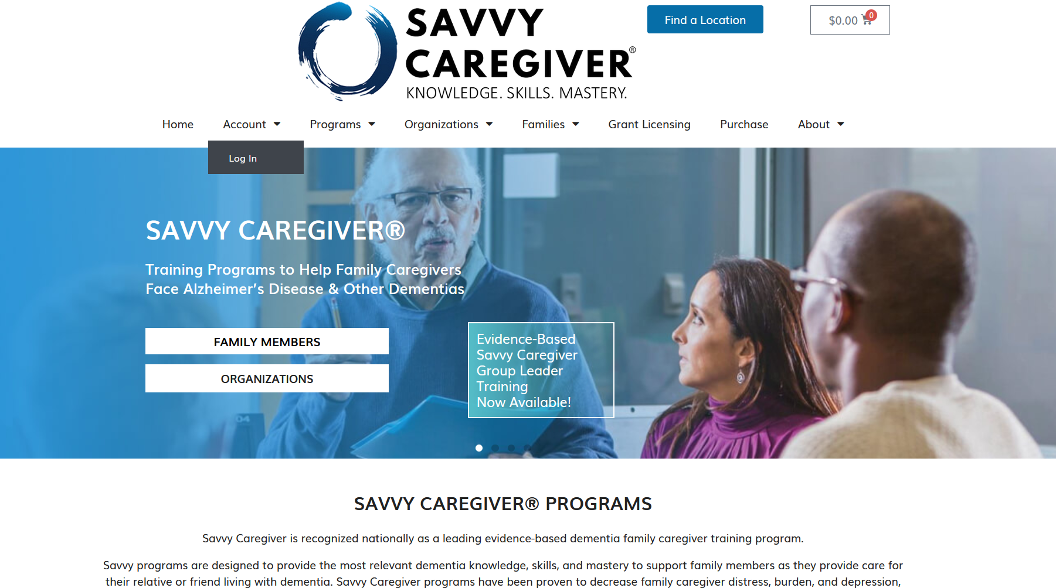
1. Log in under the “My Account” tab

Slide 5
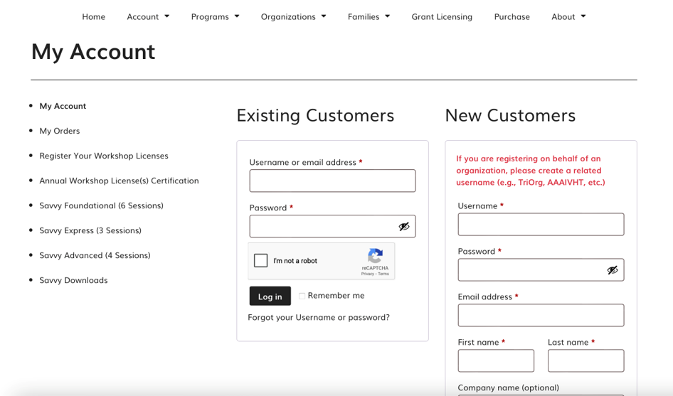
2. Click on “Register Your Workshop Licenses”

Slide 6
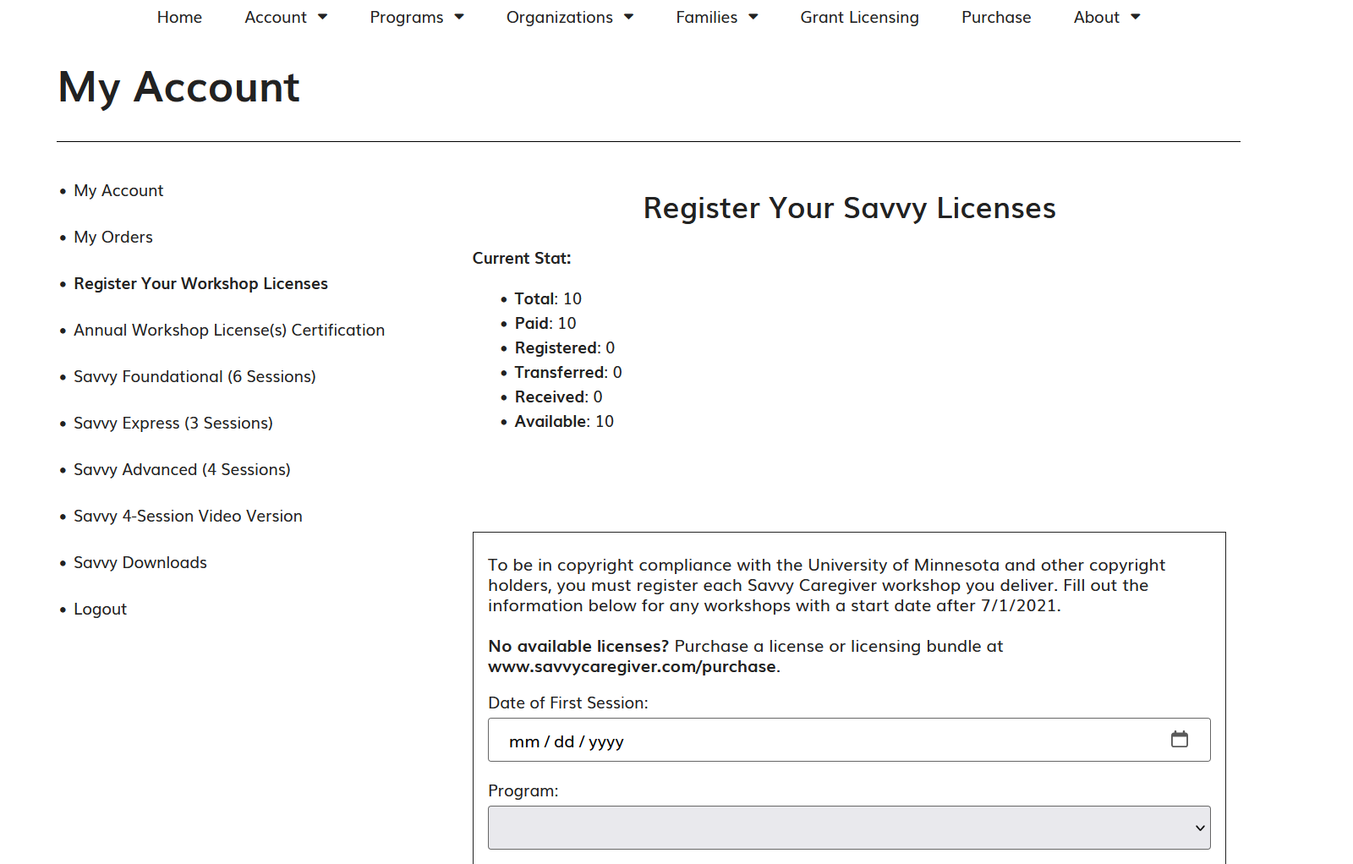
3. Complete Program Registration Information
A registration needs to be filled out for each Savvy program delivered by your organization.

Slide 7
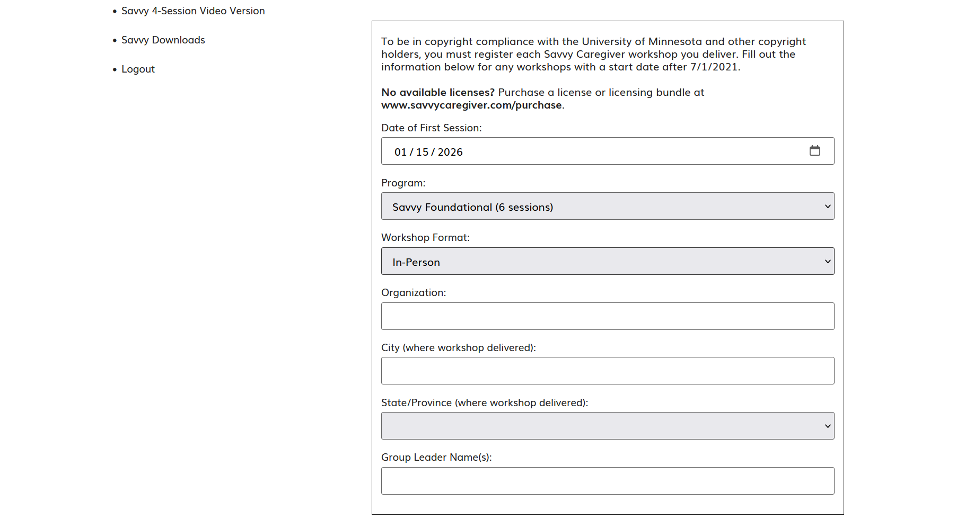
3a. Enter Program Details
Enter date of first session, program type, workshop format, organization name, city, state and group leader name (via drop-downs).

Slide 8
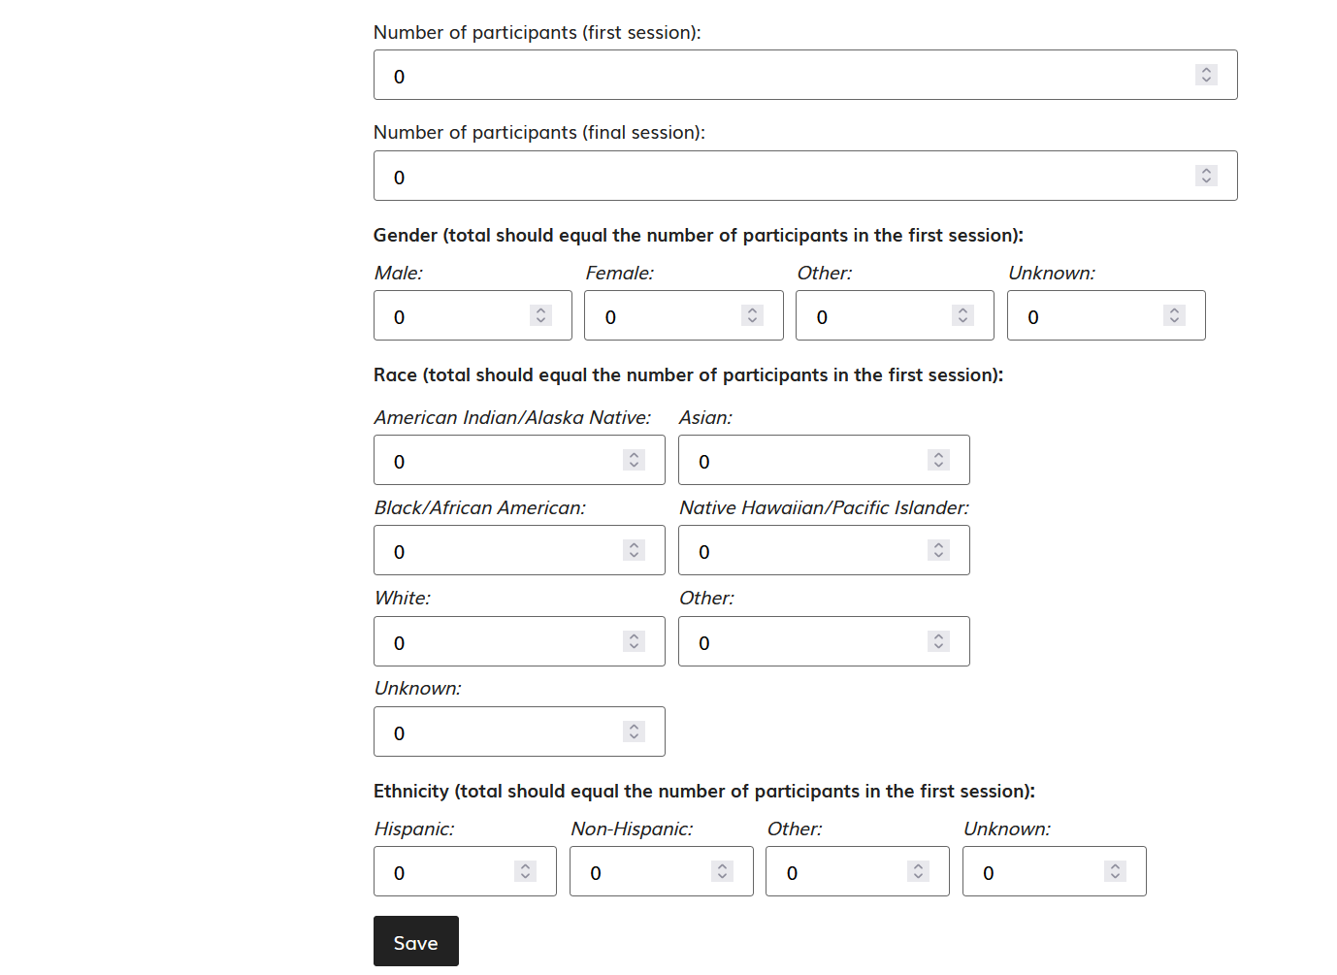
3b. Complete Demographic Information
Provide attendance and demographic information as applicable for each program, then click Save to complete the registration.
You may come back and edit registration info if necessary.

Slide 9
3c. My License Did Not Save (Duplicate Licenses)
If you do not see a newly saved license, you registered right away, you do not need to re-register it. Simply refresh your browser, and the license will appear.
  Alternatively, the previously saved license will also appear after you register and save the next license.
Example: If you register a Foundational license that began on June 10, 2025, it may not appear in your list immediately after clicking Save. Refreshing your browser will make it visible.
  Alternatively: If you then register and save another license that began on August 14, 2025, the June 10, 2025, license will appear at that time.
At present duplicate entries cannot be deleted.

Slide 10
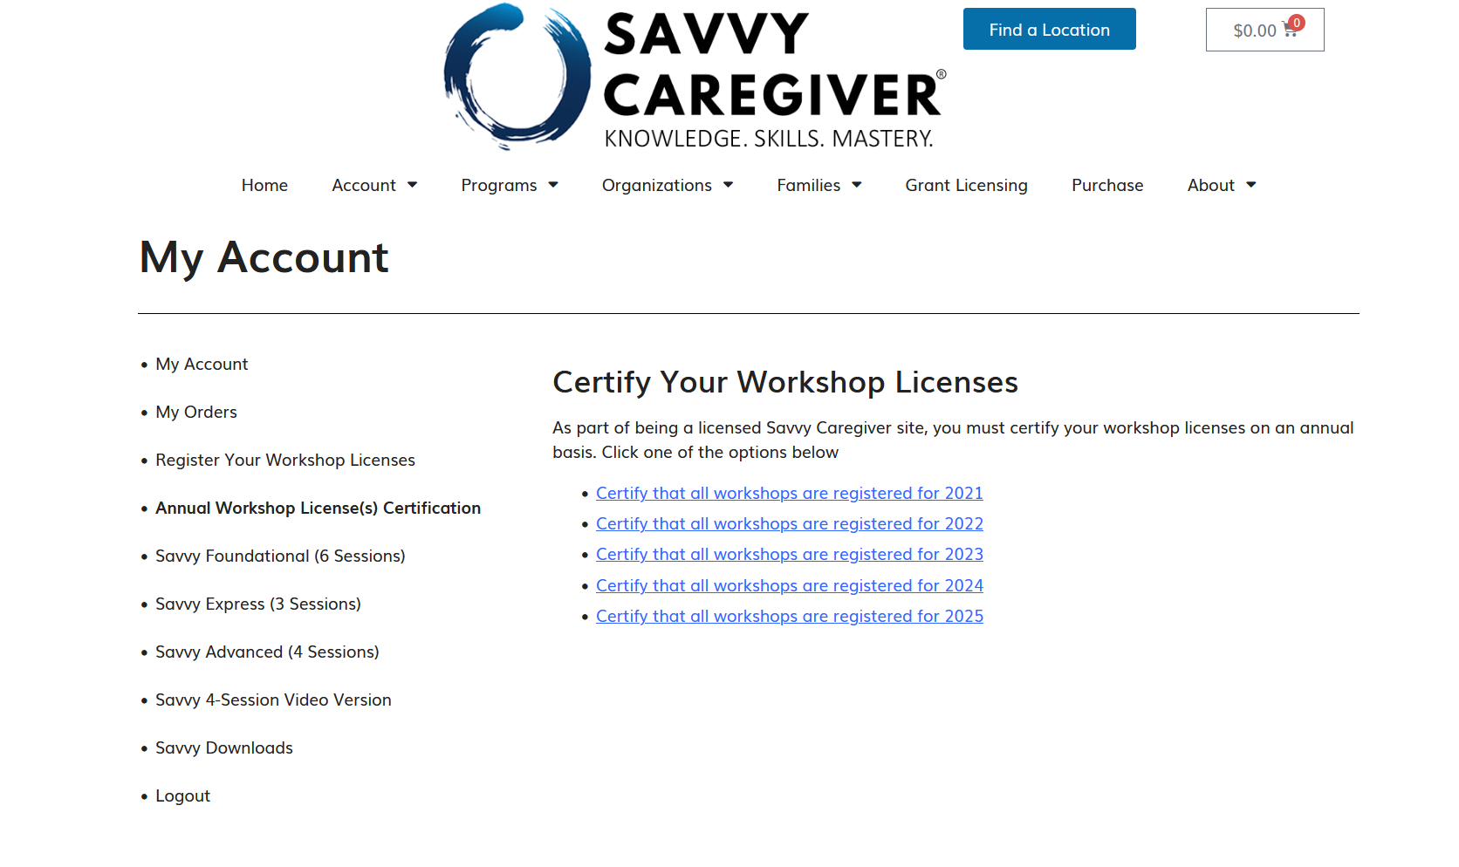
4. Certify all Savvy Programs have been Registered
Once all delivered programs have been entered, they must be certified annually beginning with 2021.

Slide 11
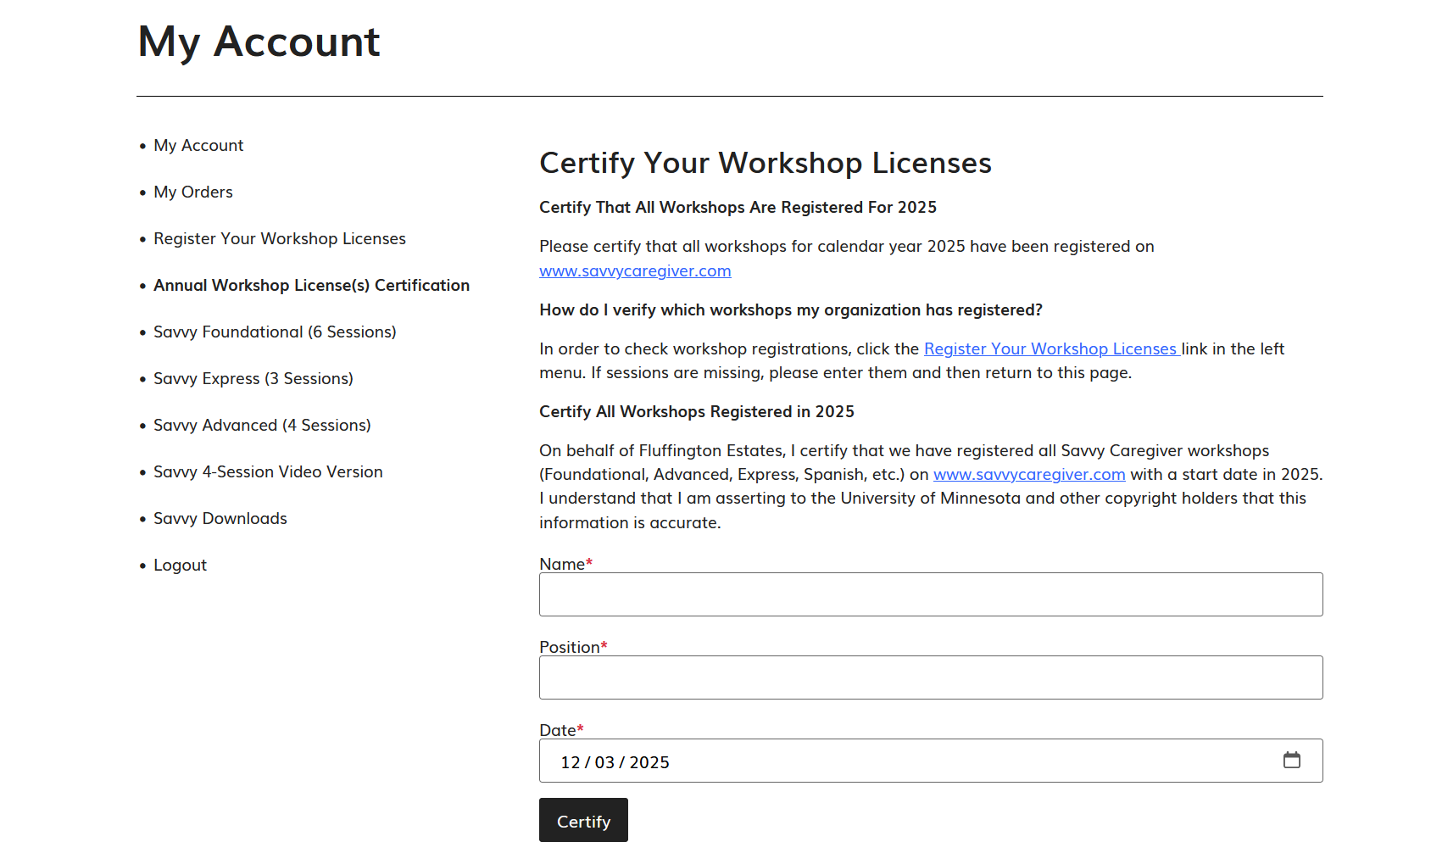
4a. Complete & Certify Savvy Programs Form
Please have the appropriate person in your organization complete and certify your Savvy programs annually, beginning with 2021.

Slide 12
5. Questions
Contact info@savvycaregiver.com
If you need to purchase licenses for past years, please do so here: https://savvycaregiver.com/purchase/
Do we need to certify years where we did not offer any Savvy programs?
  Yes, please certify for all years beginning with 2021 even if you did not offer any Savvy Programs

